Slide 1
Tema 3
DESARROLLO DE LAS DESTREZAS LINGUISTICAS: COMPRENSIÓN Y EXPRESIÓN ORAL, COMPRENSIÓN Y EXPRESIÓN ESCRITA. LA COMPETENCIA COMUNICATIVA

Slide 2
TABLE OF CONTENTS
0. Introduction
1. The spoken word
  1.1. Listening
  1.2. Speaking
2. The written word
  2.1. Reading
    2.2. Writing
3. Integrative skills
  3.1. Reasons for integrating skills
  3.2. Integration advantages
4. Communicative competence
5. Conclusions

Slide 3
Introduction
To use the language effectively we need to have a number of abilities.
The major skills: listening, reading, speaking and writing.
They may be classified in two ways:
  in relation to the medium
  In relation to the activity of the speaker.
SKILL | MEDIUM | AURAL/SPEECH | VISUAL/WRITTEN
RECEPTIVE |  | listening | reading
PRODUCTIVE |  | speaking | writing

Slide 4
1. The spoken word
The Spoken Word: the development of pupils’ ability to understand, respond to spoken language as well as to communicate effectively.
  1.1 LISTENING
  1.2. SPEAKING

Slide 5
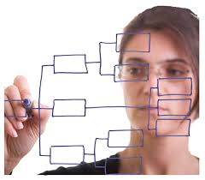
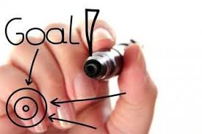
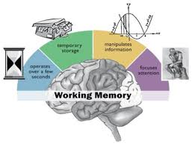


1. The spoken word. Listening.
1.1. Listening
1.1.1. General principles in teaching listening skills
The following principles must be borne in mind when designing a listening class:
  Definite goals, carefully stated.
  Step by step planning.
  Active students’ participation.
  Stress conscious memory work.
  Teach, not test.

Slide 6
1. The spoken word. Listening.
1.1. Listening Extensive
Intensive
1.1.2. Intensive and Extensive Listening
  Extensive Listening
  The language level is within students’ capacity and they listen for pleasure and interest.
  Can be long or short.
  Do not require direct control of the teacher.

Slide 7
1. The spoken word. Listening.
  Intensive Listening:
    The most widely used
    Students listen with the aim of collecting and organizing the information.
    Contains more concrete information and often not so easy to understand.
    Short passages, played several times.

Slide 8
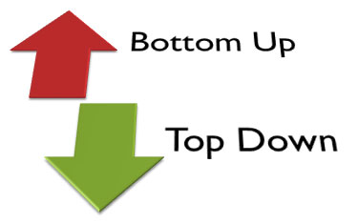
    1.1.3. Strategies for Developing Listening Skills
      Top-down strategies
        Are listener-based activities
        The listener taps into background knowledge of the topic.
        Top –down strategies include: listening for the main idea, predicting, summarizing, etc.
      Bottom-up strategies
        Are text based
        The listener relies on the language of the message
        Bottom-up strategies include: listening for details, recognizing cognates, recognizing word-order patterns.

Slide 9
1. The spoken word. Listening.
1.1.4. Developing Listening Activities
  Complete recall of all the information in an aural text is an unrealistic.
  MAKE YOUR LISTENING TASKS SUCCESS-ORIENTED TO BUILD-UP STUDENTS’ CONFIDENCE.
  How to do it:
    Construct the listening activity around a contextualised task.
    Define the activity’s instructional goal and type of response.
    Check the level of difficulty of the listening text.
    Use pre-listening activities.
    Match while-listening activities to the instructional goal, the listening purpose, and students’ proficiency level.

Slide 10
1. The spoken word. Speaking.
1.2. Speaking
  Speaking involves THREE AREAS OF KNOWLEDGE:
    Mechanics
      The use of the right words in the right order
    Functions
      when clarity off message is essential and when precise understanding is not required
    Social and cultural rules and norms
      Who is speaking to whom, in what circumstances, about what, and for what reason.

Slide 11
1. The spoken word. Speaking.
1.2.1. Goals and Techniques for Teaching Speaking
  Use of a BALANCED ACTIVITIES APPROACH that combines language input, structures output, and communicative output.
    LANGUAGE INPUT
      In form of teacher talk, listening activities, reading texts, language heard and read outside the class, etc.
      May be content oriented or form oriented.
    STRUCTURED OUTPUT
      Focuses on the correct form.
      Students may have options, but all of them require the use of specific language items.
    COMMUNICATIVE OUTPUT
      The learner’s main purpose is to complete a communicative task.
      The criterion of success is whether the learner gets the message across.
      Accuracy is not a consideration unless the lack of it interferes with the message.

Slide 12
1. The spoken word. Speaking.
1.2.2. STRATEGIES for Developing Speaking Skills
  USING MINIMAL RESPONSES
    Minimal responses: predictable, often idiomatic phrases that conversation participants use to indicate understanding, agreement, doubt, etc.
    Help students to focus on what the other participant is saying.
  RECOGNIZING SCRIPTS
    Some communication situations are associated with a predictable set of spoken exchanges / SCRIPTS.
    Students can predict what they will hear and what they will need to say in response.
  USING LANGUAGE TO TALK ABOUT LANGUAGE
    Encouraging students to use clarification phrases in class when misunderstanding can help them to gain confidence.

Slide 13
1. The spoken word. Speaking.
1.2.3. Developing Speaking Abilities
Structured Output Activities + Communicative Output Activities
Error correction and increase of accuracy
Opportunity to practice language use more freely
INFORMATION GAP
JIGSAW ACTIVITIES
ROLE PLAYS
DISCUSSIONS

Slide 14

2. The Written word. Reading.
2.1. 1. READING PURPOSE
  Supports learning of a language in multiple ways:
    READING TO LEARN THE LANGUAGE
      Provide rich language input, including vocabulary, grammar, sentence structure, discourse structure.
    READING FOR CONTENT INFORMATION
      To obtain information
    READING FOR CULTURAL KNOWLEDGE AND AWARNESS
      Insight into the lifestyles and worldviews

Slide 15
2. The Written word. Reading.
2.1.2. READING AS AN INTERACTIVE PROCESS
READING = THE READER THE TEXT
Uses knowledge, skills and strategies to decode meaning.
Letters, words, sentences, paragraphs to encode meaning.
Grammatical competence: elements of writing system, vocabulary, sentence structures
Discourse competence: discourse markers, how they connect the part of the text
Sociolinguistic competence: different types of texts and their usual structure and content
Strategic competence: top-down and bottom-up strategies.

Slide 16
2. The Written word. Reading.
2.1.3. GOALS AND TECHNIQUES FOR TEACHING READING.
  Goal: to produce students who are able to FEND FOR THEMSELVES IN COMMUNICATIVE SITUATIONS.
  Instructors use READING STRATEGIES to maximize their comprehension of text, identify relevant and non-relevant information, and tolerate less than word-by-word comprehension.
  Instruction in READING STRATEGIES not an add-on, but an integral part of the use of reading activities.

Slide 17
2.1.4. INTEGRATING READING STRATEGIES
Instructors can help their students to become effective readers by teaching them HOW TO USE READING STRATEGIES before, during and after reading.
  BEFORE READING: PLAN FOR THE READING TASK.
  Set a purpose/ decide what to read
  Linguistic /background knowledge
  Top-down or bottom-up strategy
  DURING AND AFTER READING: MONITOR COMPREHENSION.
  Verify predictions/check for inaccurate guesses
  What is important to understand
  Reread to check comprehension
  Ask for help.
  AFTER READING: EVALUATE COMPREHESION AND STRATEGIES USED.
  Comprehension in a particular task
  Overall progress in reading and in particular types of reading tasks
  Evaluate the strategies used and modify them if necessary

Slide 18
2.1.5.STRATEGIES FOR DEVELOPING READING SKILLS
Instructors should help to develop a set of reading strategies that help students to read more quickly and efficiently.
  PREVIEWING
    Reviewing titles, section headings, etc.
  PREDICTING
    Make predictions about content and vocabulary, discourse structure, writing style, etc.
  SKIMMING AND SCANNING
    Use a quick survey to get the main idea
    Looking for a specific piece of information
  GUESSING FROM CONTEXT
  PARAPHRASING

Slide 19
2. The Written Word. Reading.
2.1.6. DEVELOPING READING ACTIVITIES
  A fully developed reading activity supports students as readers through pre-reading, while-reading and post-reading activities.
  Reading activities should be success oriented and build up students’ confidence:
    Constructed around a significant purpose
    Clearly defined goal and the type of response
    Level of difficulty

Slide 20
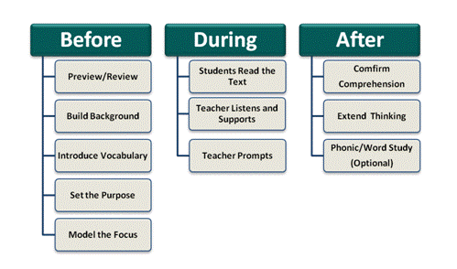

Slide 21
2. The Written Word. Writing.
2.2.1. WRITING ACTIVITIES
In the early stages of learning English, pupils write very little. They mostly start with GUIDED COPYING to produce words or sentences.
INITIAL GUIDED WRITING activities may be oriented at both word- and sentence- level.
When the students have mastered some of the basic skills in writing, we should encourage them to start with INDEPENDENT WRITING (letters, cards, experiences).
Making lists, matching labels to diagrams, classifying words under labels, etc.
Writing captions for pictures, matching halves of sentences and copying, answering questions, etc.

Slide 22
2.2.2. WRITING SKILLS (MATTHEWS, 1991)
  GRAPHIC SKILLS
    Writing graphemes, spelling, punctuation and capitalization.
  GRAMMATICAL SKILLS
    The ability to use a variety of sentence patterns and constructions.
  STYLISTIC SKILLS
    The ability to express precise meanings in a variety of styles or registers.
  RHETORICAL SKILLS
    The ability to use cohesive devices in order to link parts of a text.
  ORGANISATIONAL SKILLS
    The sequencing of ideas, reject irrelevant information and summarize relevant points.

Slide 23
3. INTEGRATING THE SKILLS
INTEGRATED SKILLS can be defined as a process by means of which a series of activities of tasks use any combination of the four linguistic skills.
3.1. Reasons for integrating the skills
According to Read (1991):
  To practise and extend the pupils’ use of a particular language item
  To develop the pupils’ ability in two or more skills within a constant context

Slide 24
3.2. Integration advantages
  CONTINUITY
    Activities are not performed in isolation, but in a closely related way
  INPUT BEFORE OUTPUT
    One activity’s input may provide motivation for next activity output.
  REALISM
    A realistic, communicative framework
  APPROPRIATENESS
    Appropriate language
  VARIETY
    Varied activities foster motivation
  RECYCLING
    Allows for recycling and revision of language.
  CONFIDENCE
    A weakness in one skill can be compensated with the strength in other skills.
  The skill integration will lead to the development of Communicative Competence.

Slide 25

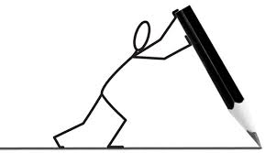

How to integrate different linguistic skills: an example
Students watching a video
STEP 1
Teacher writing some useful words and expressions for students to repeat and memorize
STEP 2
Students role-play a conversation in which they put into practice the intonation, the accent and the expressions they have seen/listened to before.
STEP 3

Slide 26
4. COMMUNICATIVE COMPETENCE
The concept of COMMUNICATIVE COMPETENCE:
FIRSTLY INTRODUCED BY CHOMSKY (1957)
Defined the language as a “set of sentences, each finite in length and constructed out of a finite set of elements”.
An able speaker has a subconscious knowledge of the grammar rules of his language which allows him to make sentences in that language (COMPETENCE).
HYMES
Argued that Chomsky had missed the rules of use.
Replaced Chomsky’s notion of COMPETENCE with the concept of COMMUNICATIVE COMPETENCE:
  Systematic potential (a native speaker possesses a system that has a potential for creating a language).
  Appropriacy (what language is appropriate in a given situation).
  Occurance (how often something is said in the language)
  Feasibility (whether something is possible in the language)/

Slide 27
4. COMMUNICATIVE COMPETENCE
DEVELOPED BY CANALE AND SWAIN (1980)
COMMUNICATIVE COMPETENCE =
GRAMMATICAL COMPETENCE (grammar rules) + SOCIOLINGUISTIC COMPETENCE (the rules of language use).
The four components of communicative competence (CANALE):
Grammatical competence
  Producing a structured comprehensible utterances
Sociolinguistic competence
  Involving knowledge of the sociocultural rules of language and discourse
Discourse competence
  Communicating in different genres, using cohesion and coherence
Strategic competence
Enhancing the effectiveness of communication and compensating for breakdowns in communication

Slide 28
4. COMMUNICATIVE COMPETENCE
SAVIGNON (1983) described how these four components interact .
“Communicative competence is a dynamic rather than a static concept. It depends on the negotiation of meaning between two or more persons who share to some degree the same symbolic system. In this sense, communicative competence can be said to be an interpersonal rather than intrapersonal trait.”
In the context of language teaching, the term COMMUNICATIVE COMPETENCE generally refers to the ABILITY TO PERFORM OR COMMUNICATE.

